Slide 1

Accelerating FEMTO
My tooth and nail fight with Numba
M Vishnu Sankar
18B030013

Slide 2
Contents
Motivation & Introduction to Numba
Unforgiving Numba and Ways around!
Breaking Down the Problem
Modifying the Code
Results

Slide 3
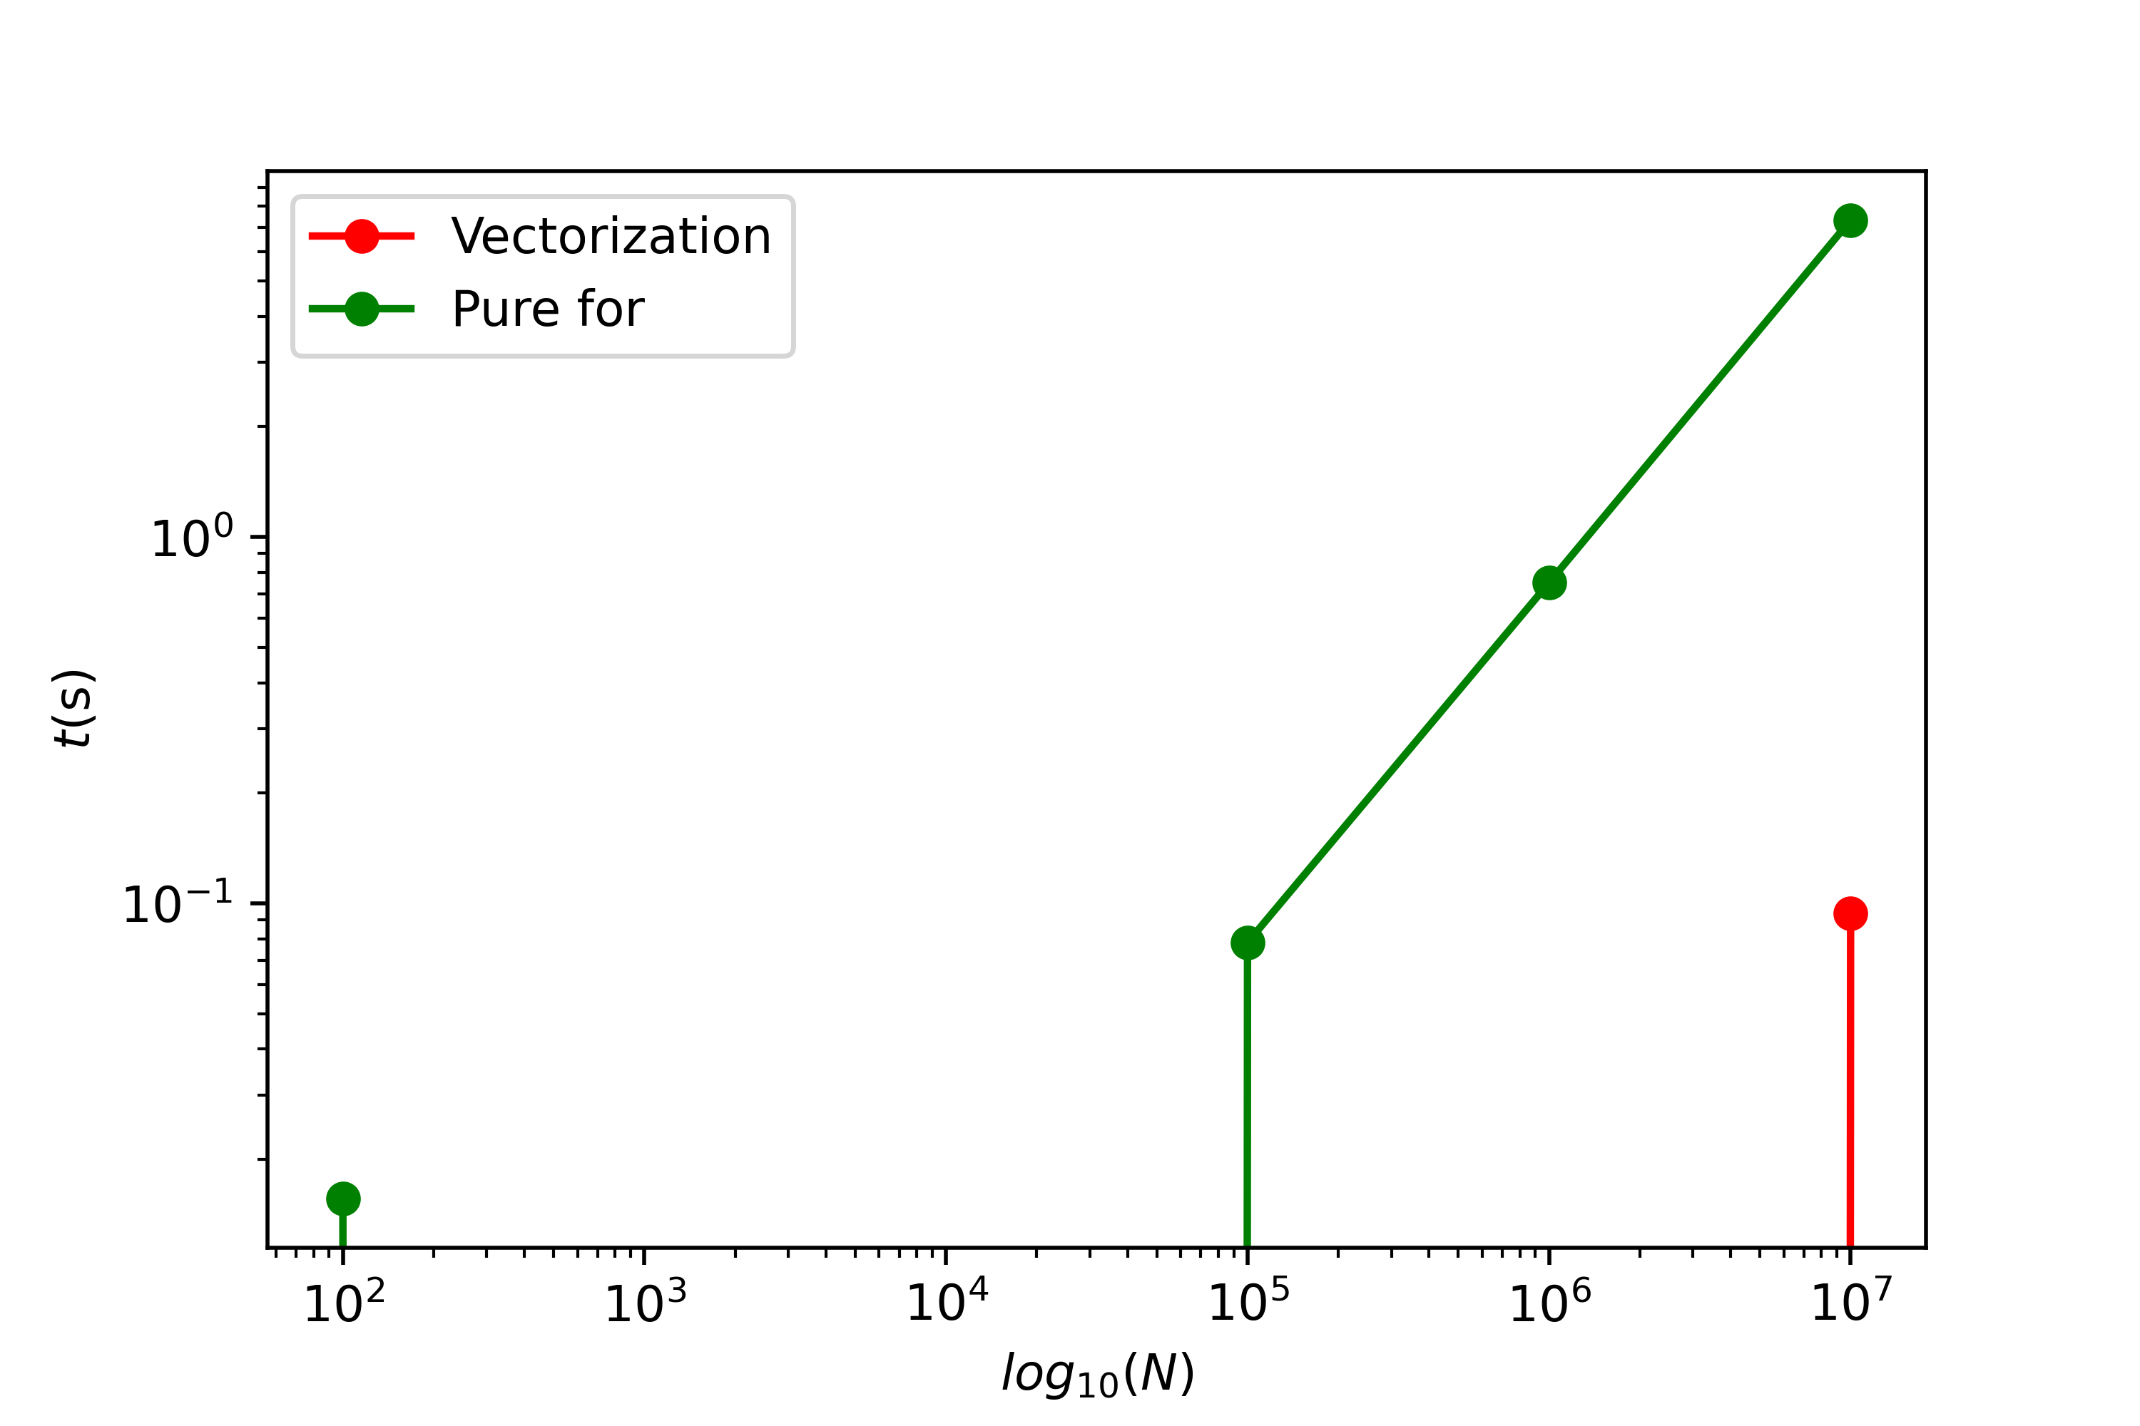
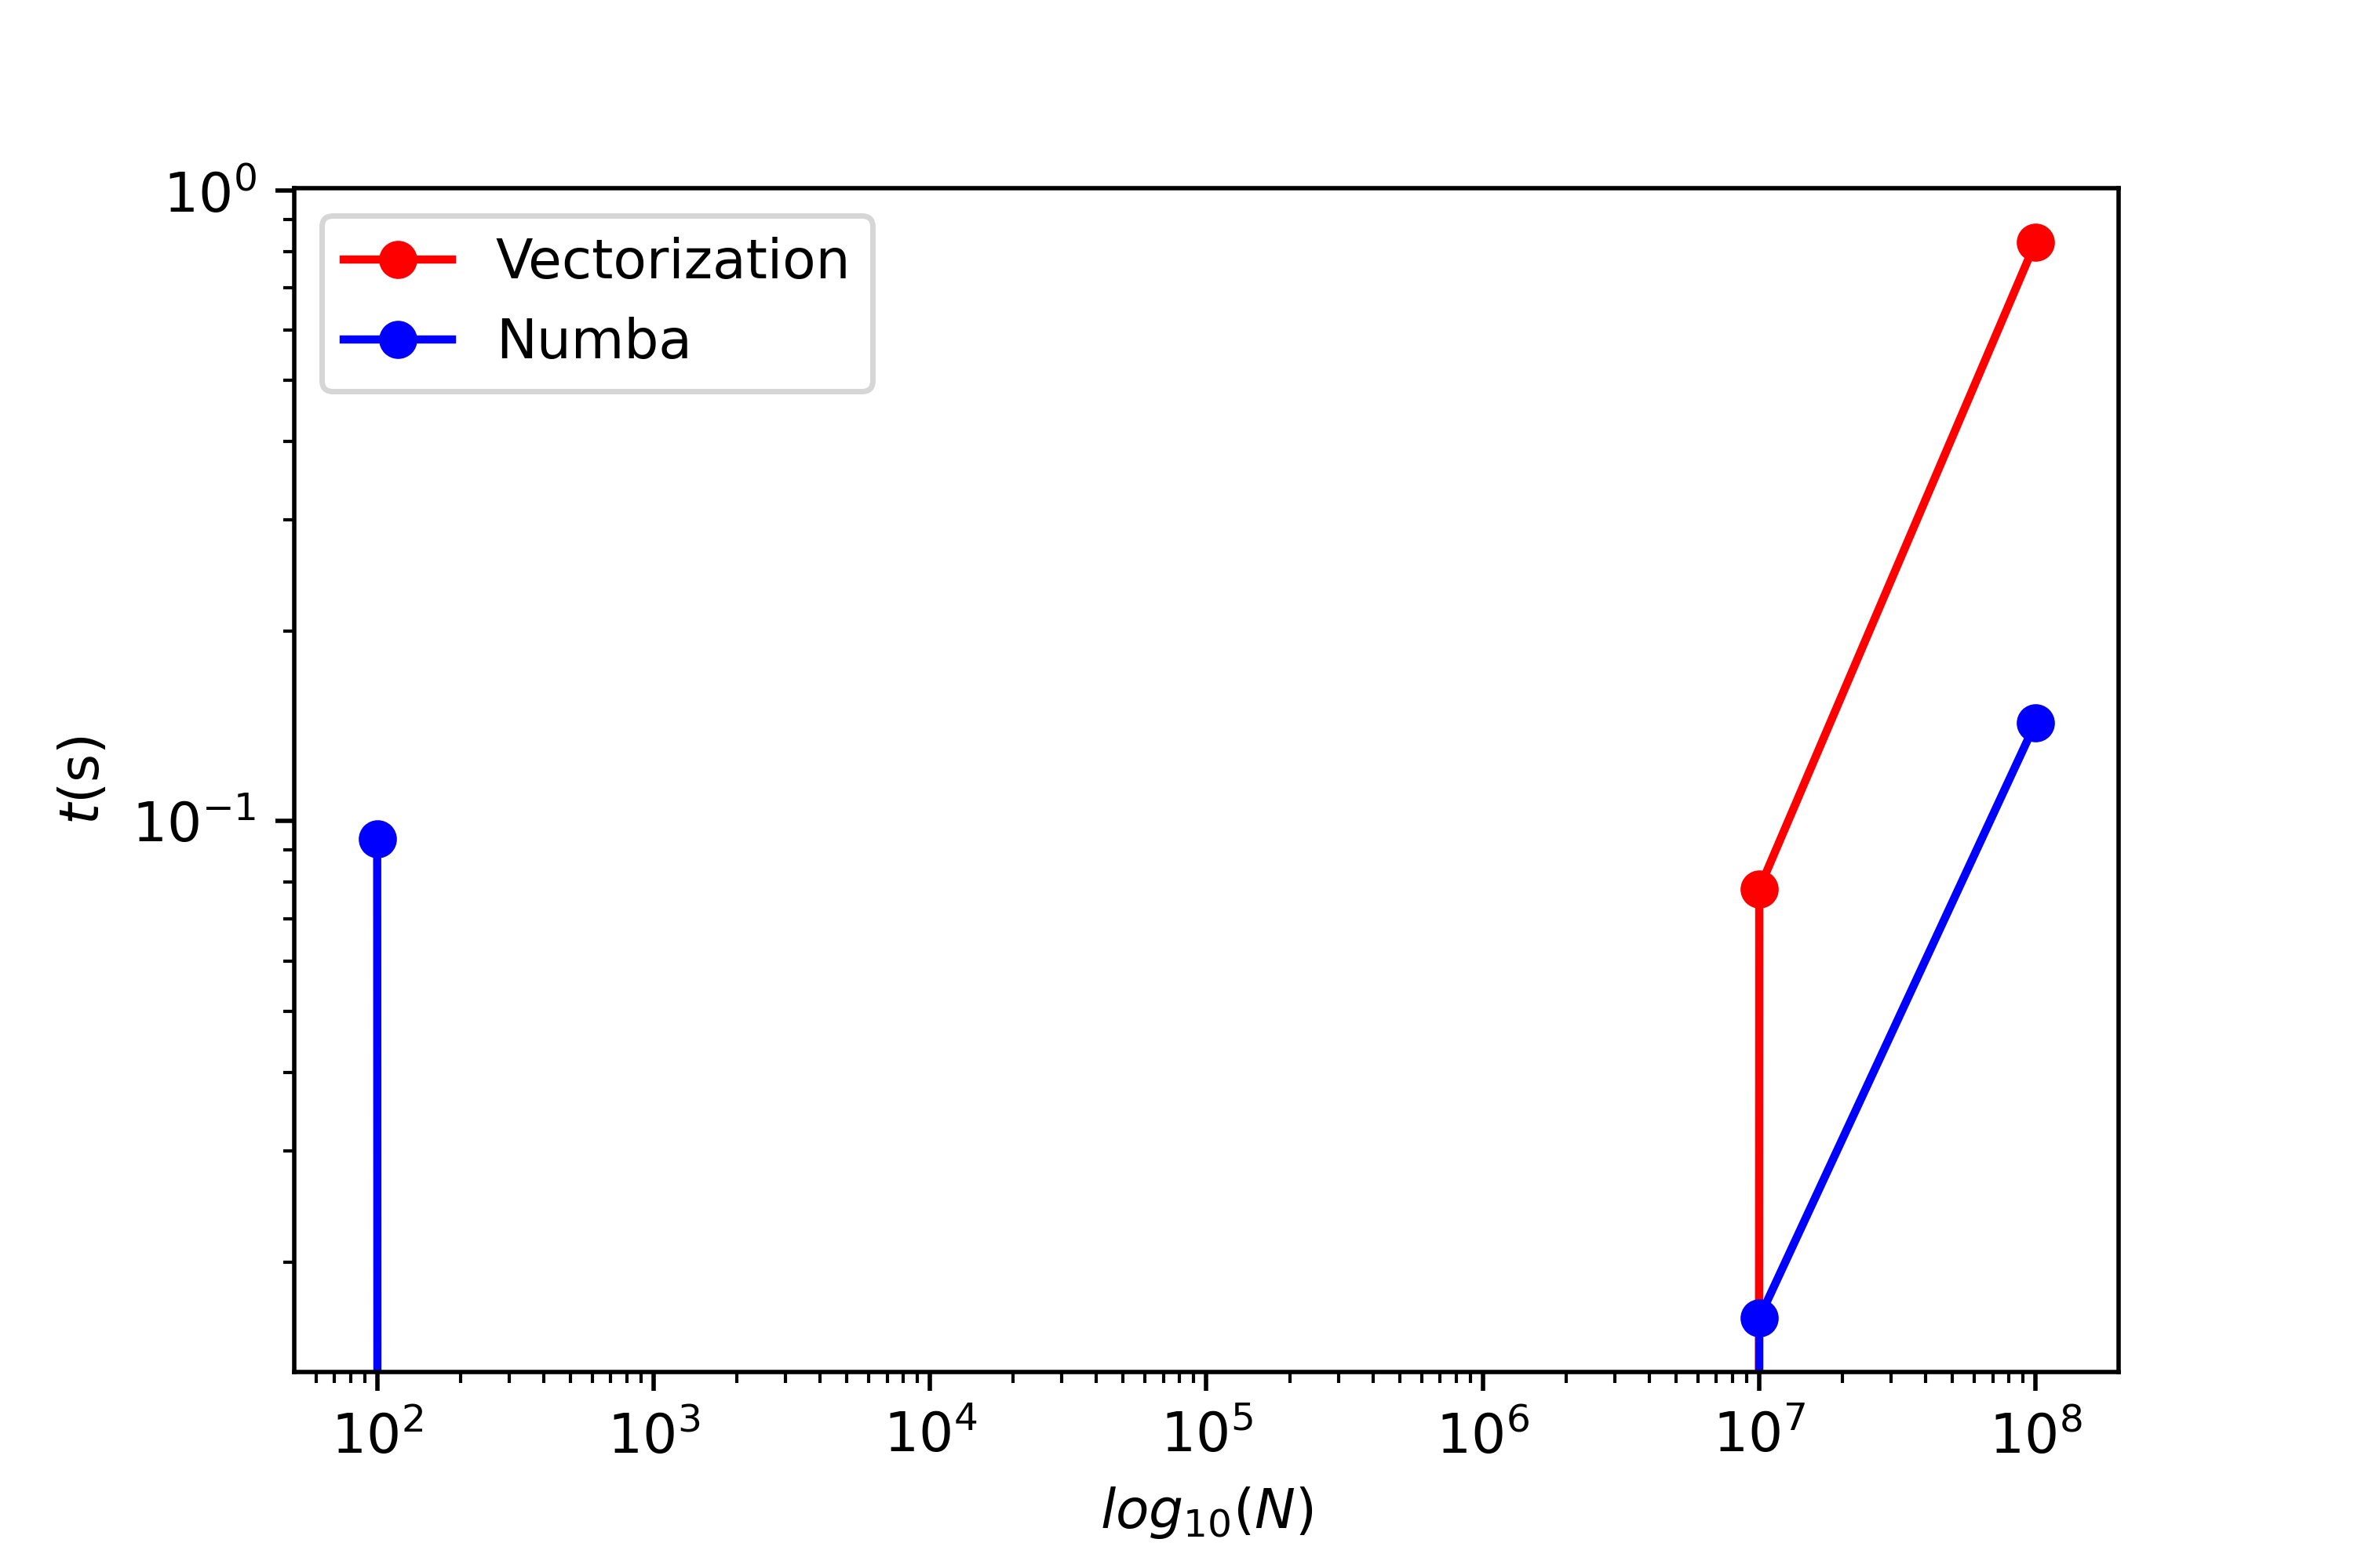
Motivation
Adding squares: x_i**2 + y_i**2

Slide 4



Numba = Numpy + Mamba
Numba logo
Numpy logo
Source

Slide 5
Introduction to Numba
OpenSource JIT – Just in time compiler
Uses LLVM compiler library
Generates Machine Code from Python code
Stores it in memory

Slide 6
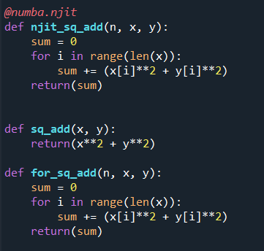
Code of Initial Problem | Advantages
Works best with numpy arrays
Supports many numpy features
High speed-up if used carefully
Both easy and difficult to use

Slide 7
Unforgiving Numba and Ways around!
Does not support
Dict
Pure python function & class as argument
List – gives poor performance
NJIT'ed functions inside Python for loops are terrible
Function
NJIT all dependent functions
Use only Numpy arrays
User caller functions separately
Static Method – No implicit first argument needed (self)

Slide 8
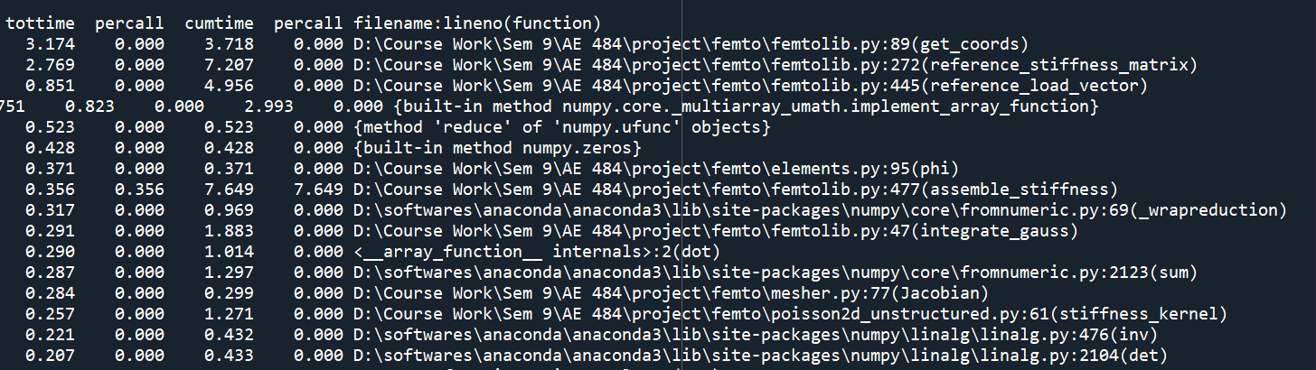
Breaking Down the Problem - cProfiling

Slide 9
Modifying the Code

Slide 10
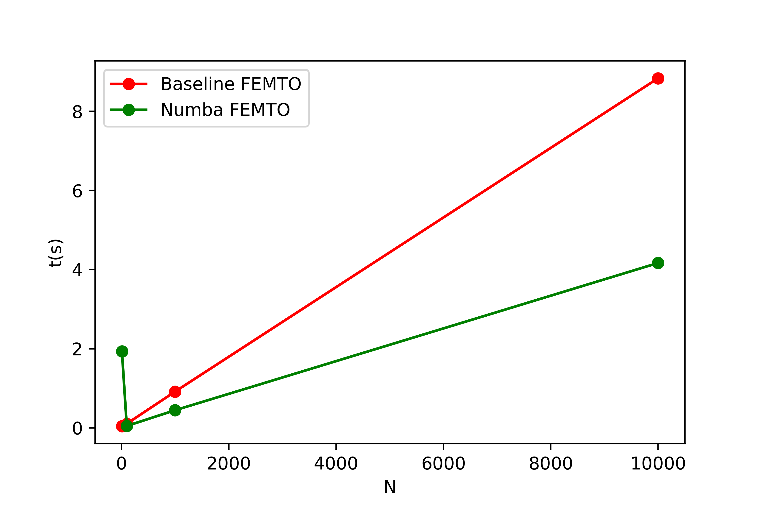
Results
Speed up ~ 41% faster

